Slide 1
Diabetes risk prediction
CAPSTONE PROJECT
Presented By:
Arumuga Perumal S
9513- Jayaraj Annapackiam CSI College of Engineering
B.E Mechanicl Engineering

Slide 2
OUTLINE
Problem Statement
Proposed System/Solution
System Development Approach
Algorithm & Deployment
Result
Conclusion
Future Scope
References

Slide 3
Problem Statement
Design and implement a comprehensive analysis to identify key factors contributing to the risk of diabetes in a target population. Utilize available health data, lifestyle indicators, genetic predispositions, and environmental factors to develop predictive models and recommendations for effective diabetes risk reduction strategies. The analysis should consider both individual-level risk factors and population-level trends to inform targeted interventions and public health initiatives.

Slide 4
Proposed Solution
Here's a proposed solution for a diabetes risk reduction analysis:
Data Collection: Gather comprehensive data from various sources including healthcare records, lifestyle surveys, genetic testing, environmental factors and socio-economic indicators.
Data Preprocessing: Cleanse and preprocess the collected data by handling missing values, outliers, and standardizing formats to ensure consistency.
Feature Selection: Use statistical methods and domain knowledge to select relevant features that have a significant impact on diabetes risk, such as BMI, blood sugar levels, family history, physical activity levels, diet patterns, etc.
Exploratory Data Analysis (EDA): Conduct EDA to gain insights into data distributions, correlations, and trends. Visualize the data using charts, graphs, and heat maps to identify patterns and relationships.
Predictive Modeling: Develop predictive models such as logistic regression, decision trees, random forests, or support vector machines to predict diabetes risk based on the selected features. Use techniques like cross-validation and hyper parameter tuning to optimize model performance.
Risk Assessment: Use the trained models to assess the risk of diabetes for individuals in the target population. Provide risk scores or classifications based on the model predictions.

Slide 5
System Approach
Define Objectives and Scope:
Clearly outline the goals of the analysis, such as predicting diabetes risk, identifying key risk factors, and recommending interventions.
Define the target population (e.g., age group, demographics, health status) for which the risk reduction analysis will be conducted.
Data Collection and Integration:
Gather diverse data sources including medical records, lifestyle data (diet, exercise habits), genetic information, socio-economic factors, and environmental data.
Integrate and preprocess the data to ensure consistency, handle missing values, and standardize formats for analysis.
Feature Engineering and Selection:
Conduct feature engineering to create new features or transform existing ones to better represent diabetes risk factors (e.g., BMI, blood glucose levels).
Use statistical methods, domain knowledge, and feature selection techniques (e.g., correlation analysis, feature importance ranking) to identify the most relevant features.
Data Analysis and Modeling:
Perform exploratory data analysis (EDA) to uncover patterns, correlations, and trends in the data.
Develop predictive models to predict diabetes risk based on selected features.
Validate and optimize the models using techniques like cross-validation, hyper parameter tuning, and model evaluation metrics.

Slide 6
Algorithm & Deployment
Deploying a diabetes risk reduction analysis algorithm involves several steps to ensure its effectiveness, scalability, and usability. Here's a structured approach to deploying such an algorithm:
Model Selection and Validation
Preprocessing Pipeline
Scalable Infrastructure
API Development
User Interface (UI)
Security and Compliance
Testing and Quality Assurance (QA)
Deployment Strategy
Documentation and Training
Monitoring and Maintenance

Slide 7
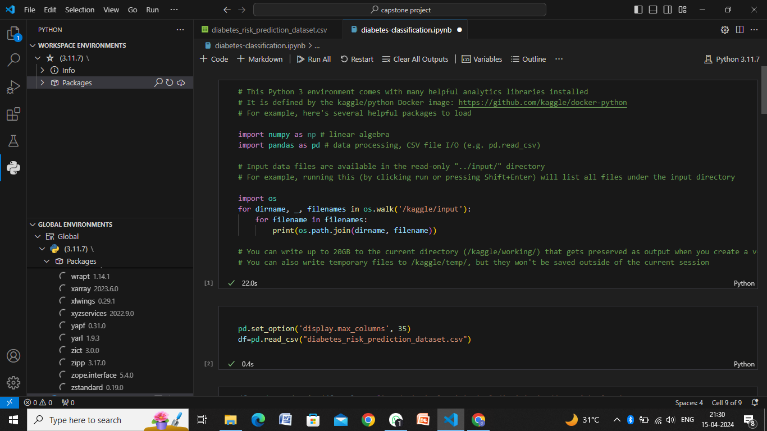
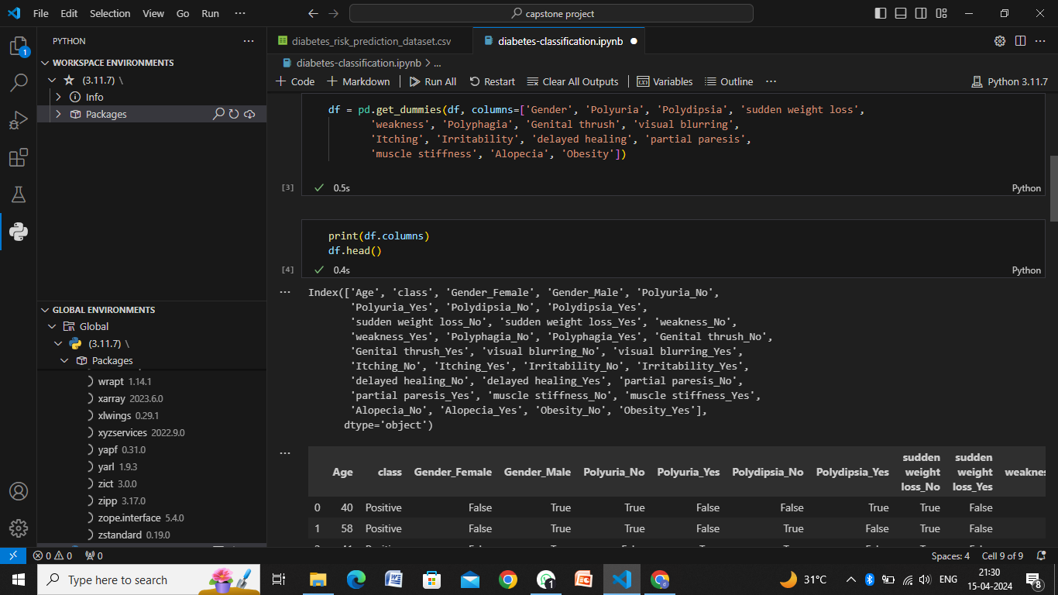
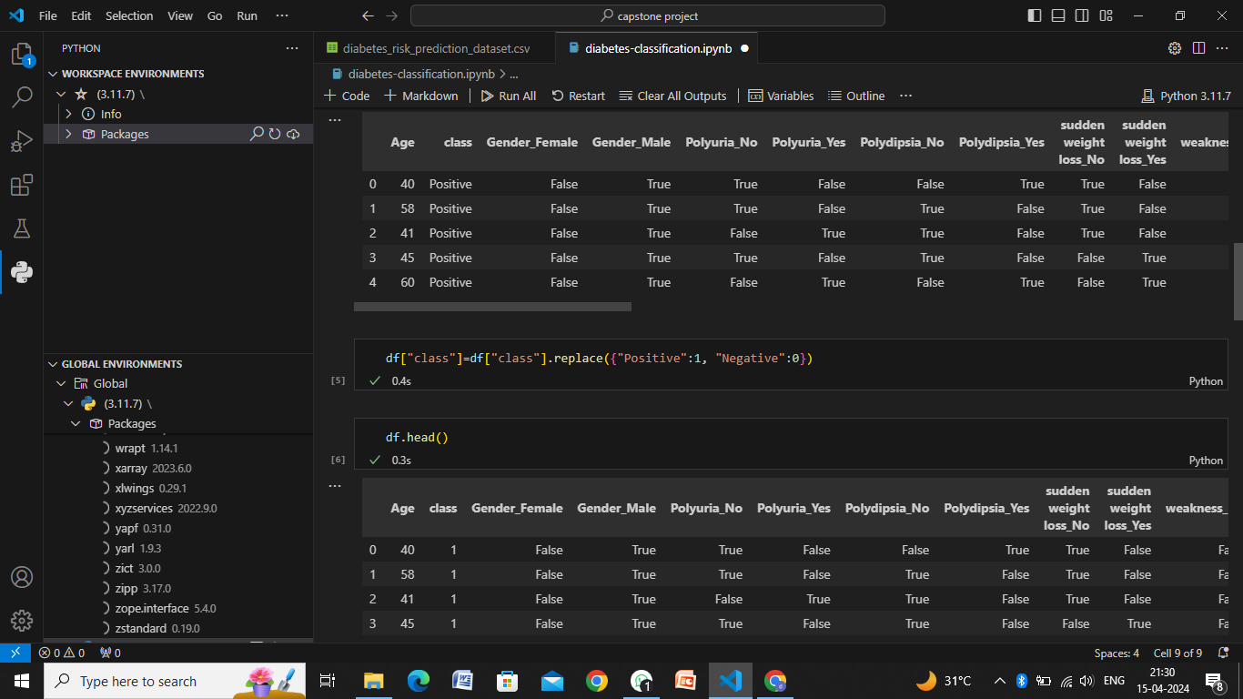
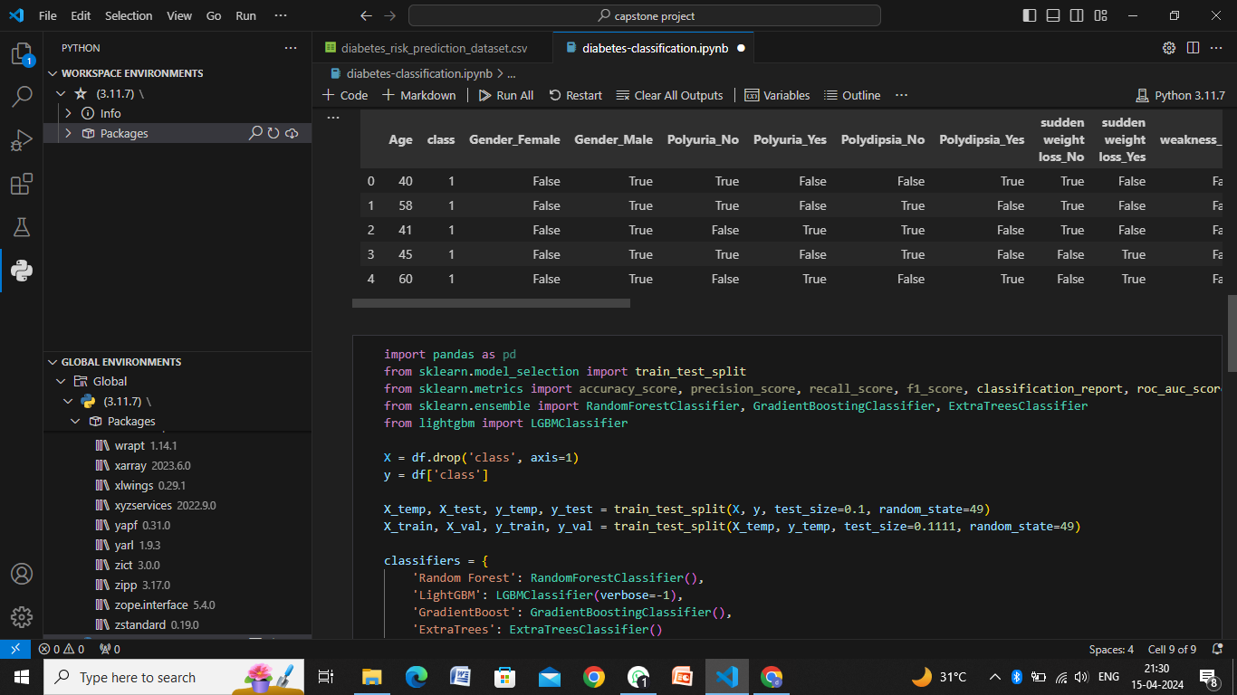
Result

Slide 8
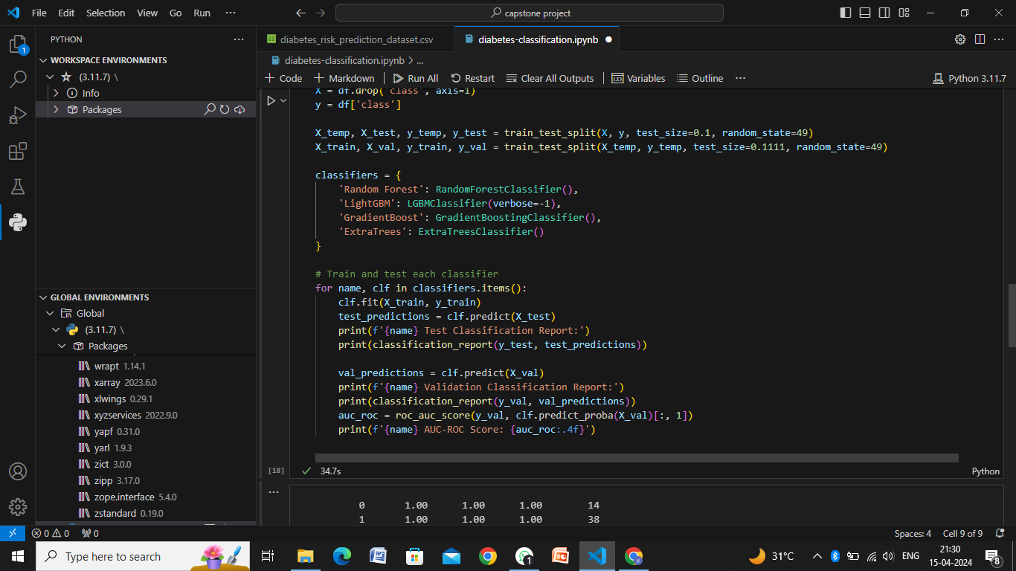
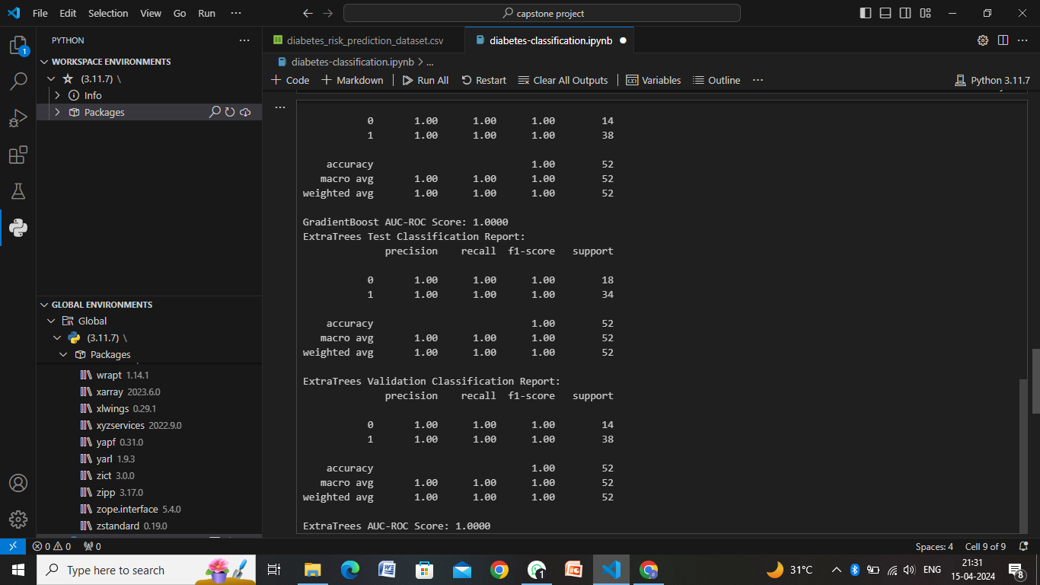
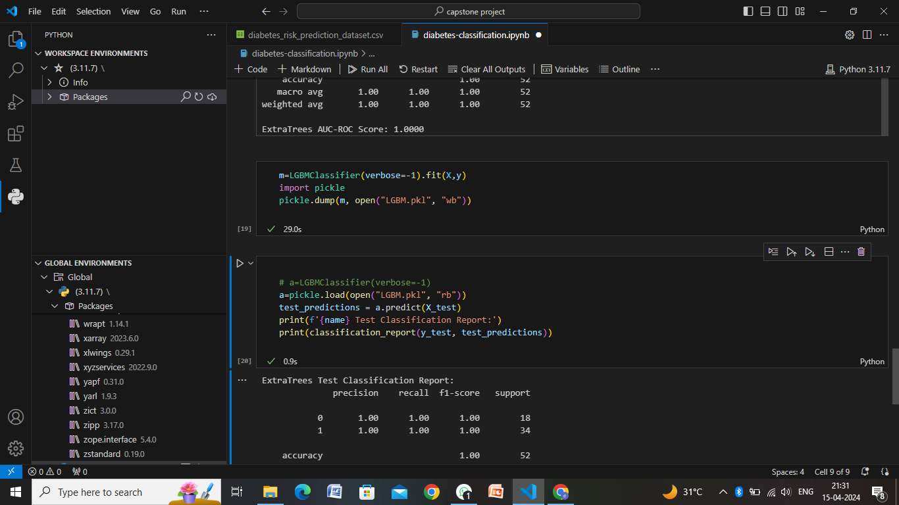


Slide 9
Conclusion
In conclusion, a diabetes risk reduction analysis is a comprehensive and multidimensional approach aimed at understanding, predicting, and mitigating the risk of diabetes in individuals and populations. Through the integration of advanced data analytics, predictive modeling, and personalized interventions, such an analysis can significantly contribute to improving public health outcomes and reducing the burden of diabetes-related complications.
Key points to consider in the conclusion of a diabetes risk reduction analysis are:
Risk Identification
Predictive Modeling
Personalized Interventions
Continuous Improvement
Empowering Individuals
Public Health Initiatives

Slide 10
Future scope
The future scope of diabetes risk reduction analysis is promising, with advancements in technology, data science, and healthcare practices opening up new possibilities for more effective and personalized interventions. Here are some key areas of future scope:
Integration of Wearable Technology
Genomic Risk Profiling
Artificial Intelligence and Machine Learning
Predictive Analytics for Early Detection
Behavioral Economics and Nudge Theory
Telehealth and Remote Monitoring
Population Health Management
Ethical Considerations and Data Privacy

Slide 11
References
Article Title: "Prevention or Delay of Type 2 Diabetes"
Authors: William C. Knowler, Elizabeth Barrett-Connor, Susan E. Fowler, et al.
Journal: Diabetes Care
Year: 2002
Link: Diabetes Care
Article Title: "Risk Assessment Tools for Identifying Individuals at Risk of Developing Type 2 Diabetes"
Authors: Abdulaziz F. Al-Kaabba, Mohd A. Al-Hamdan, Mohamed A. Al-Hamdan, et al.
Journal: Saudi Medical Journal
Year: 2011
Link: Saudi Medical Journal
Article Title: "Predictive Analytics for Diabetes Risk: A Review of Current Literature"
Authors: Muhammad Zubair Asghar, Maira Ayub, Saadia Anwar, et al.
Journal: Diabetes, Metabolic Syndrome and Obesity: Targets and Therapy
Year: 2019
Link: Diabetes, Metabolic Syndrome and Obesity
Article Title: "Machine Learning Approaches for Diabetes Prediction: A Review"
Authors: Samaher Besbes, Hanen Kchaou, Henda Hajjami Ben Ghezala, et al.
Journal: Journal of Healthcare Engineering
Year: 2020
Link: Journal of Healthcare Engineering

Slide 12
THANK YOU

